Slide 1

CONTENT
CABLES
COAXIAL CABLES
APPLICATION OF CO-AXIAL CABLES
FIBER OPTIC CABLE
WHAT IS FIBER OPTIC CABLES USED FOR?
ADVANTAGES AND DISADVANTAGES OF OPTICAL FIBER
TWISTED PAIR CABLES
STP(SHIELDED TWISTED PAIR)
UTP(UNSHIELDED TWISTED PAIR)
DIFFERENCE BETWEEN STP & UTP

Slide 2
CONNECTORS
USB
RJ-11
RJ-45
F TYPE
ST AND SC
TOPOLOGY
PHYSICAL AND LOGICAL TOPOLOGY
BUS,RING,STAR,TREE,MESH,HYBRID TOPLOGIES
Asynchronous & Synchronous Transmission

Slide 3


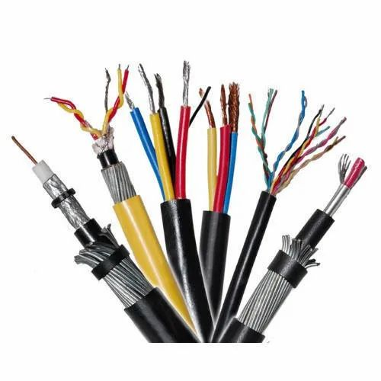
CABLES
Cables are commonly used to carry communication signals within Local Area Networks (LAN).
There are three common types of cable media that can be used to connect devices to a network and they are coaxial cable, twisted-pair cable, and fiber-optic cable.

Slide 4
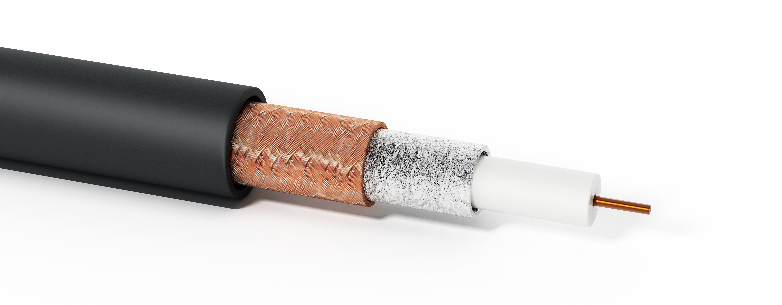
COAXIAL CABLES
A solid-core copper wire conductor runs down the middle of the cable.
Around that solid-core copper wire is a layer of insulation, and
Covering that insulation is braided wire and metal foil shield, which shields against electromagnetic interference.
A final layer of plastic insulation jacket covers the braided wire.

Slide 5
Outer conductor acts as a shield against noise & crosstalk
Over the core the insulation made of PVC is provided. Surrounding the insulation a metal screen is provided.
In thin type co-axial cable. Thickness of the core is less. while the thickness is more in thick type co-axial.
RG-8 and RG-11 (thicknet)
RG-58 (thinnet)

Slide 6
APPLICATION OF CO-AXIAL CABLES-
It is used in cables for TV camera.
Co-axial cables of less attenuation and reducer capacitance are used for transmission of RF power.
It is used in mines for communication.
It is used in CCTV system.
Bandwidth is 750 MHz
Distance is upto 500m

Slide 7
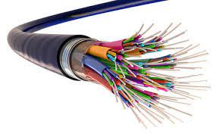
FIBER OPTIC CABLE
Fiber-optic cables transmit data via fast-traveling pulses of light.
Another layer of glass, called “cladding,” is wrapped around the central fiber and causes light to repeatedly bounce off the walls of the cable rather than leak out at the edges, enabling the single to go farther without attenuation.

Slide 8
What is fiber optic cable used for ?
Fiber optics is used for long-distance and high-performance data networking. It is also commonly used in telecommunication services, such as internet, television and telephones.

Slide 9
ADVANTAGE & DISADVANTAGE OF OPTICAL FIBER
ADVANTAGES
Higher bandwidth
Immunity to electromagnetic interface
Ressitance to corrosive
Light weight
DISADVANTAGES
Installation and maintance
Undirectional light propagation
Costlly.

Slide 10
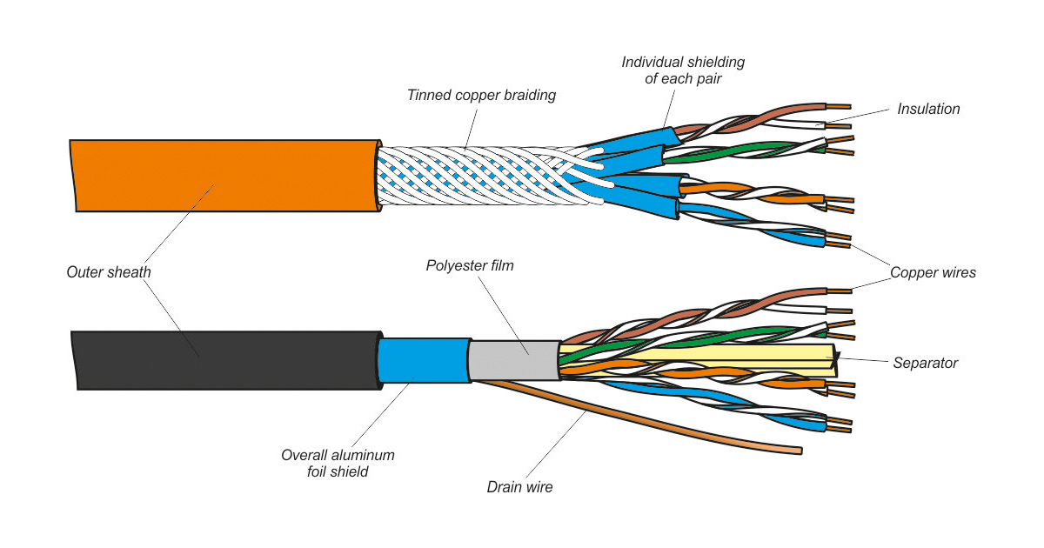
TWISTED PAIR CABLES--
A pair of wires forms a circuit that can transmit data.
The pairs are twisted to provide protection against crosstalk.
Twisted pair cabling comes in two varieties:
Shielded and unshielded
Shielded – STP
Unshielded – UTP

Slide 11
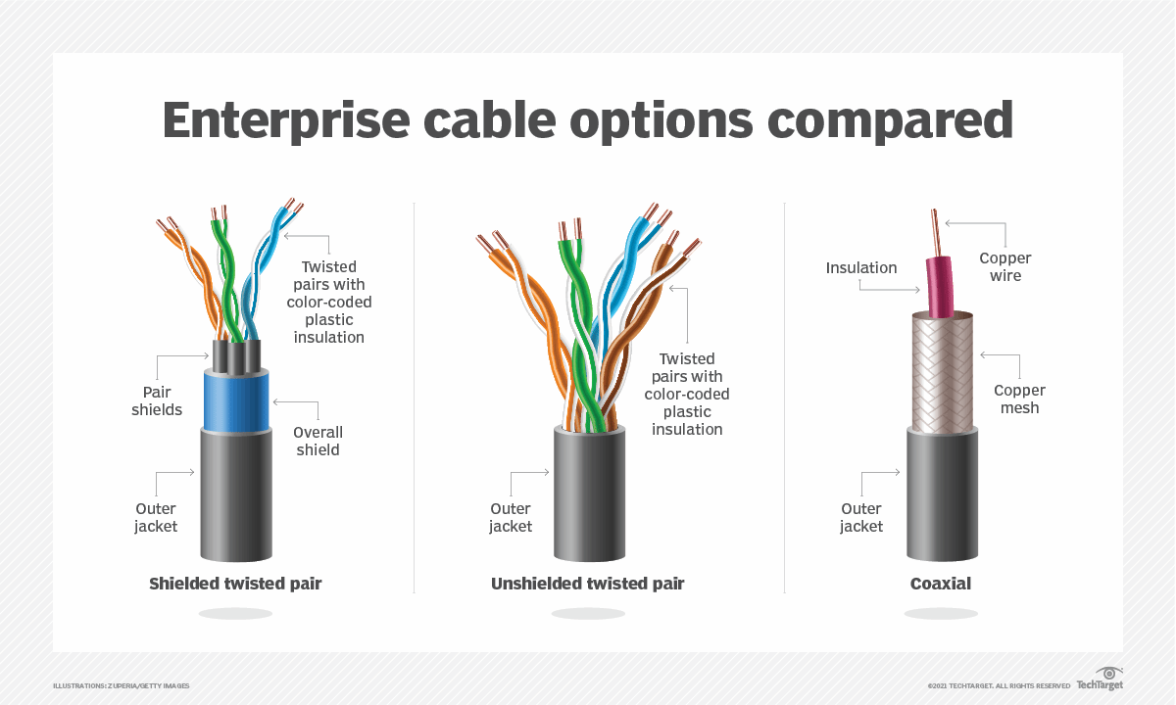
SHIELD TWISTED PAIR (STP) CABLES
Shielded twisted pair (STP) cables additionally have an overall conducting metallic shields covering four twisted pair wires.
There mat be another conducting metallic shields covering individual twisted pairs also.
These metallic shields blocks out electromagnetic interference to prevent unwanted noise from the communication circuit.

Slide 12
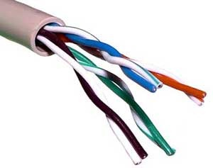
UNSHIELDED TWISTED PAIR (UTP)
Unshielded twisted pair (UTP) cable is the most common networking media .
Unshielded twisted pair (UTP) consists of four pairs of thin , copper wires covered in color-coded plastic insulation that are twisted together.

Slide 13
STRAIGHT OR CROSSOVER
Use straight-through cables for the following cabling:
Switch to Router
Switch to PC or Server
Hub to PC or Server
Use crossover cable the following cabling:
Switch to Switch
Switch to Hub
Hub to Hub
Router to Router
PC to PC
Router to PC

Slide 14
DIFFERENCE BETWEEN STP & UTP
STP(shielded twisted pair)
While in STP grounding cable is required.
Data rate in STP is high
While STP is costlier than UTP.
While in STP noise is less.
While in STP much more maintenance is needed.
While in STP speed offered is about 10 to up to 100 Mbps.
UTP(unshielded twisted pair)
In UTP grounding cable is not necessary
Data rate in UTP is slow compared to STP.
The cost of UTP is less
In UTP noise is high compared to STP.
In UTP much more maintenance is not needed.
In UTP, speed offered is about 10 to up to 1000 Mbps

Slide 15
Generally used for connecting organizations over a long distance.
Shielded Twisted Pair cable reduces Electromagnetic interference because of the protective sheath.
Usage-
Used in frigid temperatures.
Used in case of lot of heat generation like for heavy industrial applications.
Employed under high radiation conditions and more.
It is used for data transmission within short distance such as for home and office networks.
Electromagnetic interference is more in Unshielded Twisted Pair cable compared to Shielded Twisted Pair cable.
Usage-
Telephone wiring
Local Area Networks and more.

Slide 16
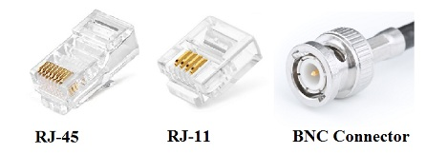
CONNECTORS
There are many network cable connector.
(Rj-45, J Rj-11, USB, MT-RJ, Coaxial BNC, LC Local Connector, MT-RJ, USB BNC and AUI ) is used to connect what type of network cable.

Slide 17
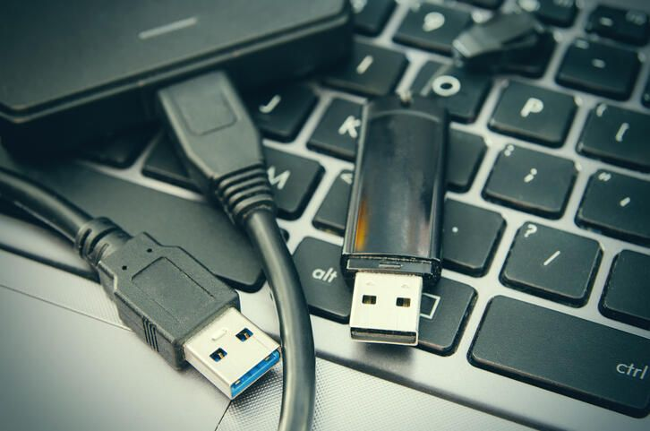
UNIVERSAL SERIAL BUS(USB)
USB is a computer standard designed to eliminate the guesswork in connecting peripherals to a PC.
It is expected to replace serial and parallel ports.
A single USB port can be used to connect up to 127 peripheral devices, such as mice, modems, keyboards, digital camera's, printers, scanners, MP3 players and many more. USB also supports Plug-and Play installation and hot plugging.

Slide 18
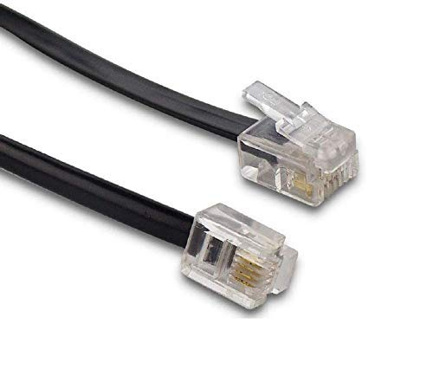
RJ-11 (Registered Jack)
Standard telephone cable connectors, RJ-11 has 4 wires (and RJ-12 has 6 wires).
RJ-11 is the acronym for Registered Jack-11, a four- or six-wire connector primarily used to connect telephone equipment.

Slide 19
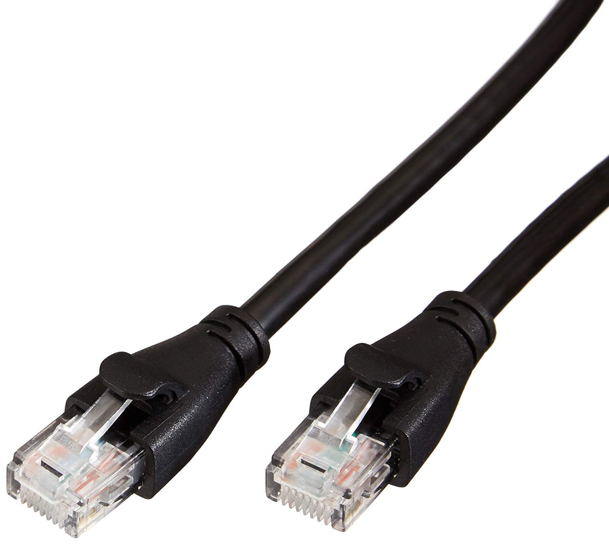
RJ-45 (Registered Jack)
The acronym for Registered Jack-45 is RJ-45
The RJ-45 connector is an eight-wire connector that is commonly used to connect computers to a local area network (LAN), particularly Ethernet LANs.
Although they are slightly larger than the more commonly used RJ-11 connectors, RJ-45s can be used to connect some types of telephone equipment.

Slide 20
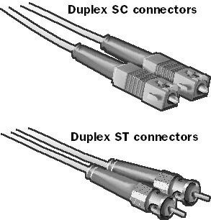
ST (Straight Tip) and SC (Subscriber Connector or Standard Connector)
Fiber network segments always require two fiber cables: one for transmitting data, and one for receiving.
Each end of a fiber cable is fitted with a plug that can be inserted into a network adapter, hub, or switch.
In North America, most cables use a square SC connector that slides and locks into place when inserted into a node or connected to another fiber cable, Europeans use a round ST connector instead.

Slide 21
TOPOLOGIES

Slide 22
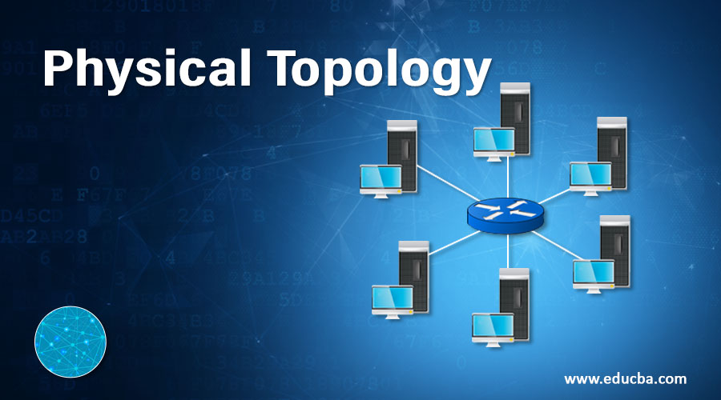
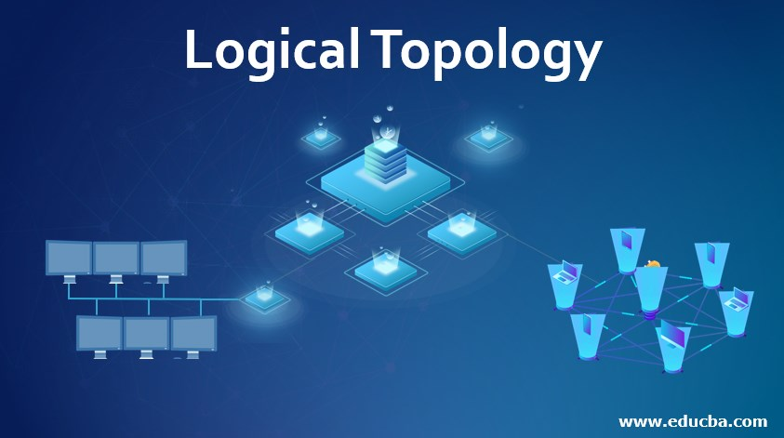
There are two types of topology :--
PHYSICAL TOPOLOGY
LOGICAL TOPOLOGY

Slide 23
PHYSICAL TOPOLOGY
Physical topology indicates arrangement of different elements of a network.
It reflects physical layout of devices and cables to a form a connected network.
LOGICAL TOPOLOGY
Logical topology reflects arrangement of devices and their communication.
It is the transmission of data over physical topology.

Slide 24
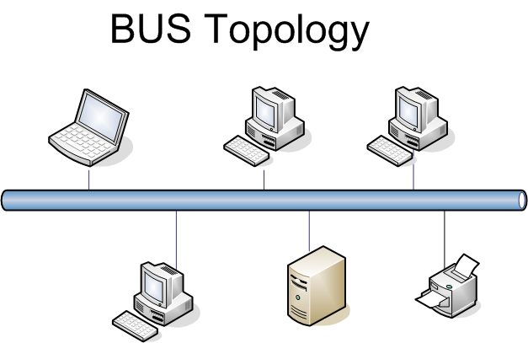
BUS TOPOLOGY
The bus topology is designed in such a way that all the stations are coonected through a single cable known as a backbone cable.
Each node is either connected to the backbone cable by drop cable or directly connected to the backbone cable.
For example- a laboratory or office.

Slide 25
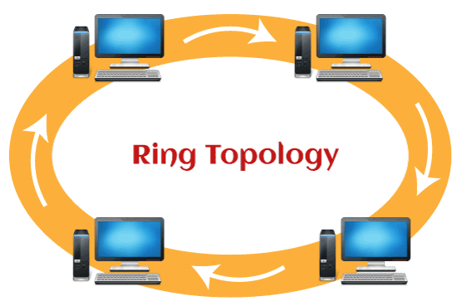
RING TOPOLOGY
Ring topology is like a bus topology, but with connected ends.
The node that receives the message from the previous computer will retransmit to the next node.
For example-a small office with only a few nodes

Slide 26
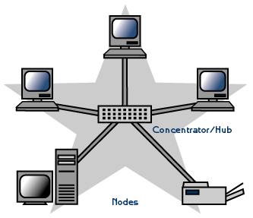
STAR TOPOLOGY
Star topology is an arrangement of the network in which every node is connected to the central hub, switch or a central computer.
The central computer is known as a server, and the peripheral devices attached to the server are known as clients.
FOR EXAMPLE-Airports, Hospitals, Banks, and Educational Institutes.

Slide 27
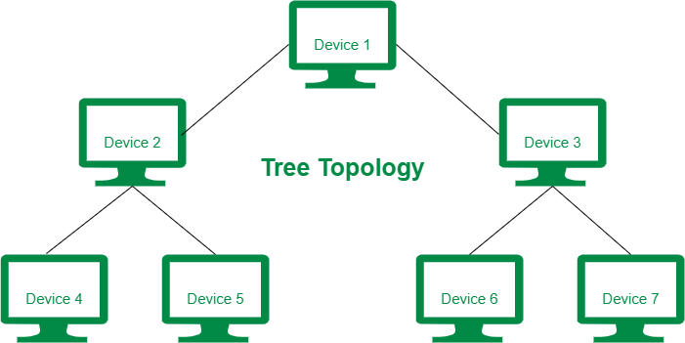
TREE TOPOLOGY
Tree topology combines the characteristics of bus topology and star topology.
A tree topology is a type of structure in which all the computers are connected with each other in hierarchical fashion
FOR EXAMPLE- printers and computers, in a home or small office.

Slide 28
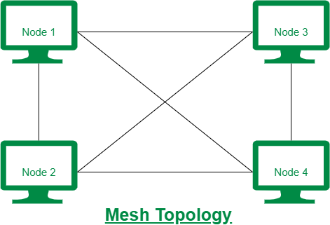
MESH TOPOLOGY
Mesh technology is an arrangement of the network in which computers are interconnected with each other through various redundant connections.
There are multiple paths from one computer to another computer.
For example-- the Internet itself

Slide 29
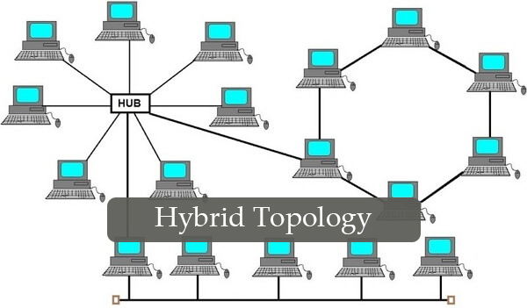
HYBRID TOPOLOGY
The combination of various different topologies is known as Hybrid topology.
A Hybrid topology is a connection between different links and nodes to transfer the data.
if you combine Ring and star topology to make bigger network then it will be called hybrid network or hybrid topology.

Slide 30
Asynchronous & Synchronous Transmission

Slide 31
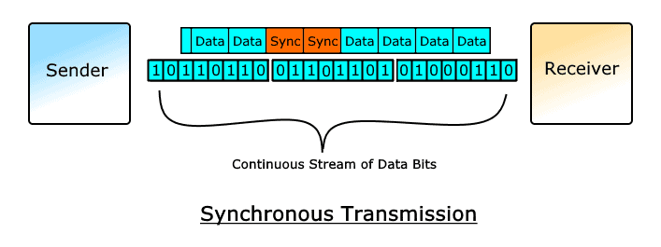
Synchronous Transmission
In Synchronous Transmission, data is sent in form of blocks or frames.
This transmission is the full duplex type.
For example-chat room

Slide 32
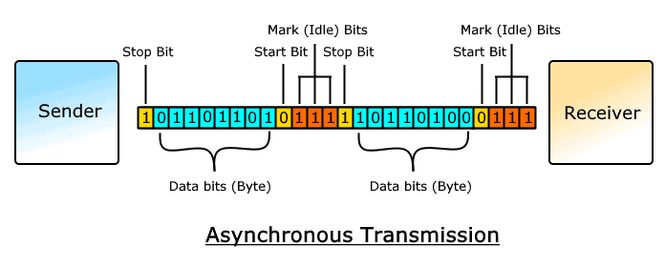
Asynchronous Transmission
In Asynchronous Transmission, data is sent in form of byte or character.
This transmission is the half duplex type transmission.
For example- an email to a colleague.

Slide 33
Difference b/w Asynchronous & Synchronous Transmission
Asynchronous Transmission
In Asynchronous transmission, data is sent in form of bytes or characters.
Asynchronous transmission is slow.
Asynchronous transmission is economical.
Synchronous Transmission
In Synchronous transmission, data is sent in form of blocks or frames.
Synchronous transmission is fast.
Synchronous transmission is costly

Slide 34
In Asynchronous transmission, there is a gap present between data.
The start and stop bits are used in transmitting data that imposes extra overhead.
Here, users do not have to wait for the completion of transmission in order to get a response from the server.
In Synchronous transmission, there is no gap present between data.
The start and stop bits are not used in transmitting data.
In this transmission, users have to wait till the transmission is complete before getting a response back from the server.

Slide 35
THANK YOU

